Slide 1



ERPwnage
Threat simulation against SAP
RED TEAM VILLAGE DEFCON 28

Slide 2
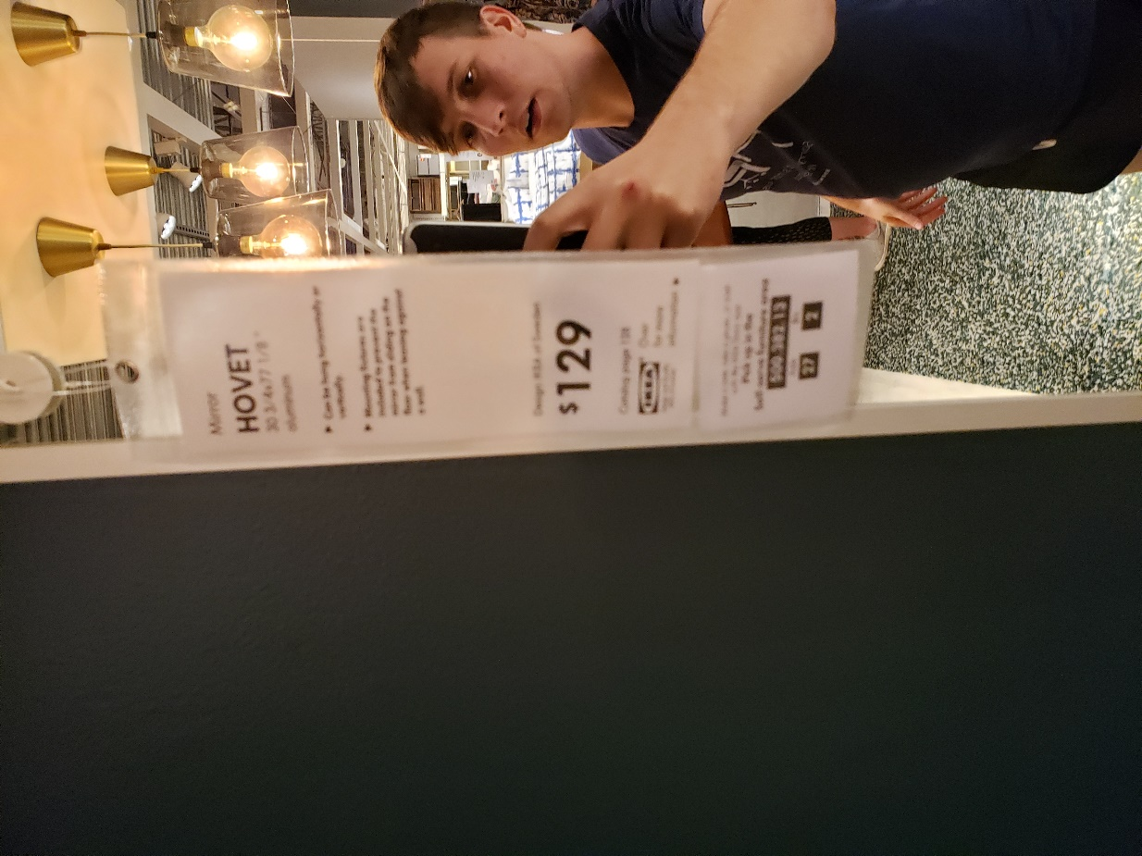





Whoami
Austin Marck
Reformed SAP Basis Administrator
Employed at RSM
http://www.amarck.com
Twitter.com/icryo
http://www.github.com/icryo
ANTHOLOGY

Slide 3

ANTHOLOGY
ERPwnage Red Team Village Lightning Talk
What?
The goal of this talk is to provide Red Teams with enough knowledge to target SAP. We’ll try to strike a balance between the new and the practical.
Why SAP?
Because it’s unnecessarily complex, difficult to update, & business critical. Some of what we’ll talk about can be applied to other ERPs but we’ll be focused on SAP. 121,100 installations world wide.
Goals of this talk
We’ll disclose some tried and true techniques for targeting SAP users and review some of the latest vulnerabilities against SAP. This lightening talk is intended to give you a very basic base of knowledge and a jumping off point for attacking SAP.
ANTHOLOGY

Slide 4

Agenda
What we will cover
What is SAP?
How do I get into SAP?
SAP is an ERP, a suite of enterprise tools for management. Enterprises have to store it all somewhere, and SAP wants to be the businesses single point of truth. Manipulation of that single point of truth is scary.
CVE - 10K Blaze, RECON, etc..
Session Hijacking
Credential Harvesting
Phishing
What impact?
Business Critical Data?
Elevation of Privilege?
Crack bigger passwords?
Pivot to new network segments?
ANTHOLOGY

Slide 5
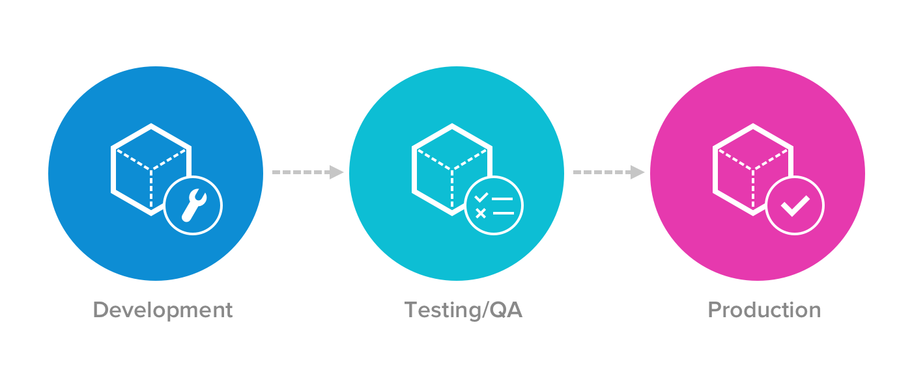
Considerations for Testing SAP
Disclaimer
TEST QA PROD
Generally the same credentials and sensitive data in all 3…
Impact
Shit’s expensive…
You bring down a DC, eh there are other DCs, you bring down ECC eh… you might be losing $$$$
ANTHOLOGY

Slide 6
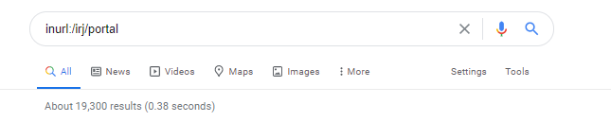
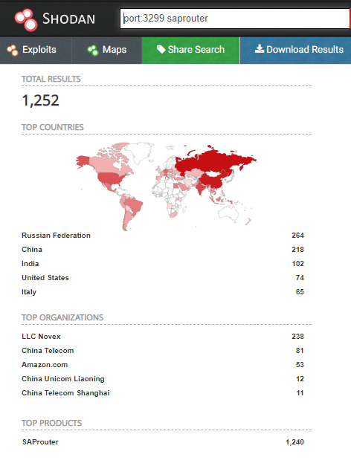
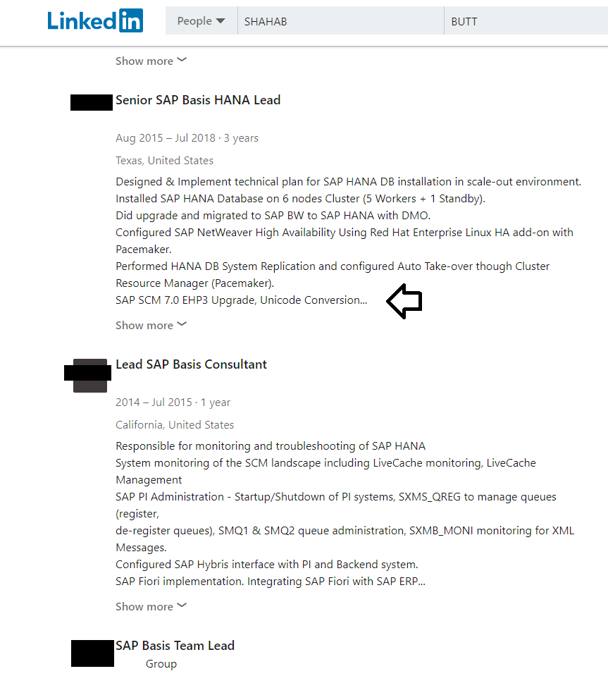
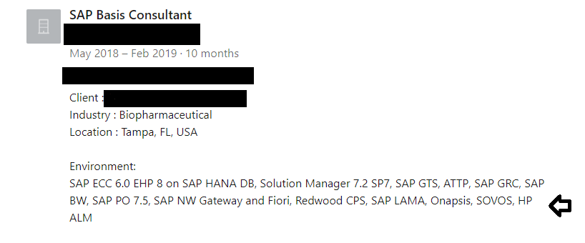
FINDING SAP?
Where’s the fun at?
SHODAN
SAP Router And like all features, this one is going to be around for a while..
Seclist – Discovery Web_content SAP.txt
SAP Case Studies
Regularly we’ll see case studies about the implementation an organization is working on.
Linkedin
Engineers regularly leak essential OS version and even patch levels on Linkedin
Sometimes they’ll also include the security platforms in use.
ANTHOLOGY

Slide 7


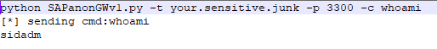
10KBlaze
Sure as heck isn’t going away soon
What?
A vulnerability in SAP that allows for remote code execution
Impact?
Code execution as <SID>ADM SAP system administrator user. Add users, dump tables, full SAP host control.
One-liner:
Python SAPanonGWv1.py –t <target> -p 3300 –c “sqlcli –U DEFAULT select mandt, bname, bcode, passcode from usr02”
ANTHOLOGY

Slide 8
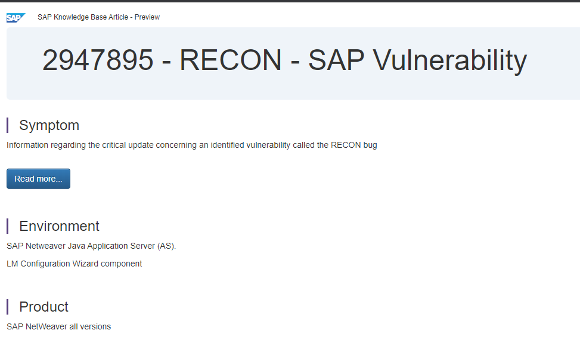
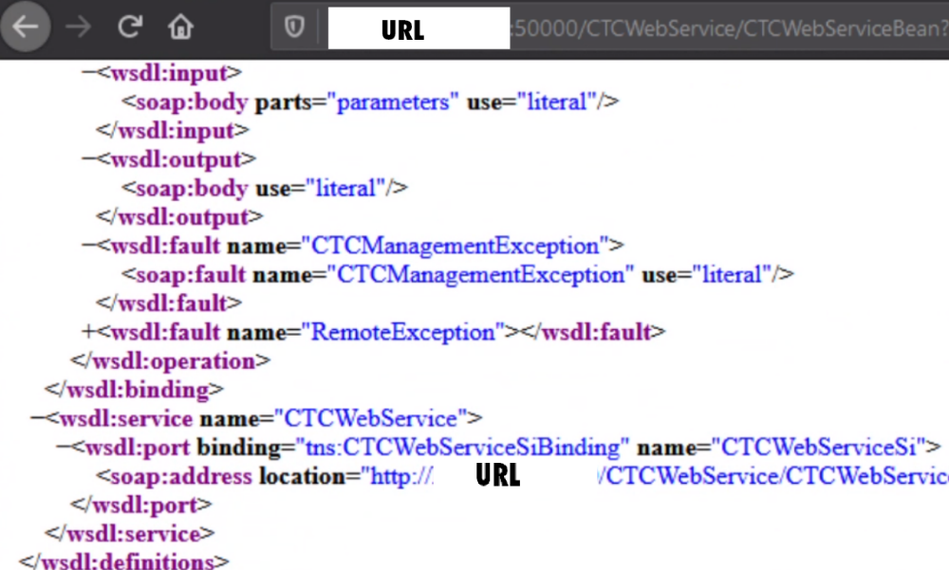
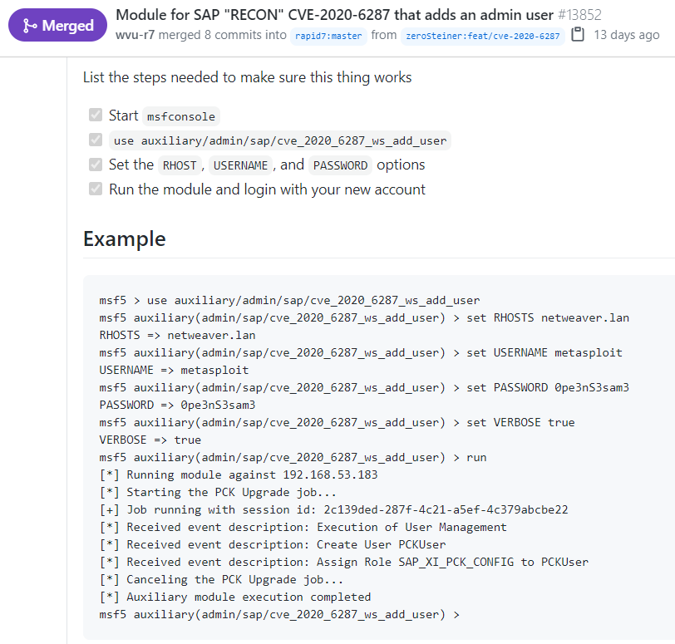
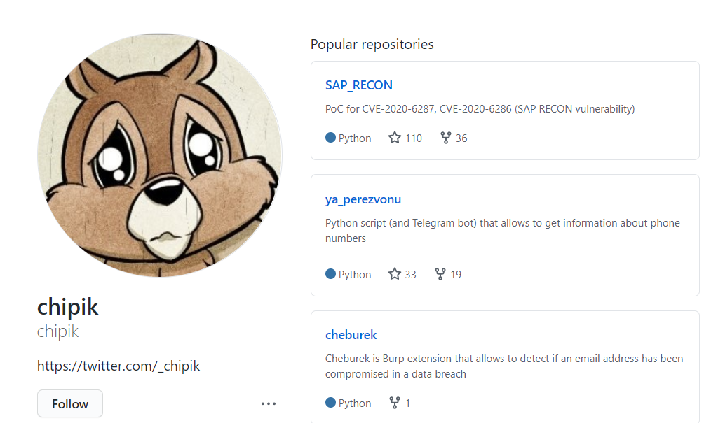
RECON
The new hotness
Shoutout
https://github.com/rapid7/metasploit-framework/pull/13852
https://github.com/chipik/SAP_RECON
@zerosteiner @_chipik
Original Researchers
CVE-2020-6287: Pablo Artuso CVE-2020-6286: Yvan 'iggy' G.
ANTHOLOGY

Slide 9
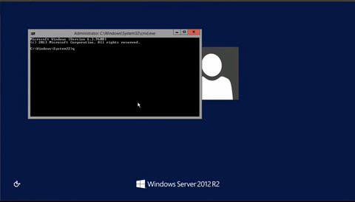
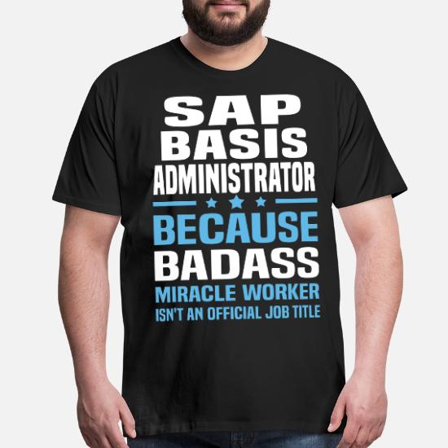
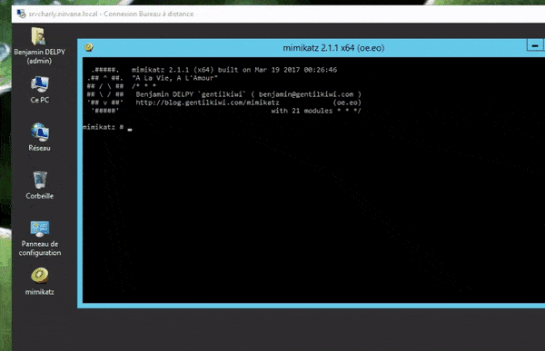
Fast Tracking your Career
As a Basis Admin
What's basis?
Fancy word for SAP Admin .. A very useful target when trying to gain access into SAP. Typically have elevated rights and may have access to sensitive network segments. Frequently have more access than required…
Your Access is my Access
Almost always have a user group in AD
Regularly post their contact info on intranet
https://doublepulsar.com/rdp-hijacking-how-to-hijack-rds-and-remoteapp-sessions-transparently-to-move-through-an-da2a1e73a5f6
ANTHOLOGY

Slide 10
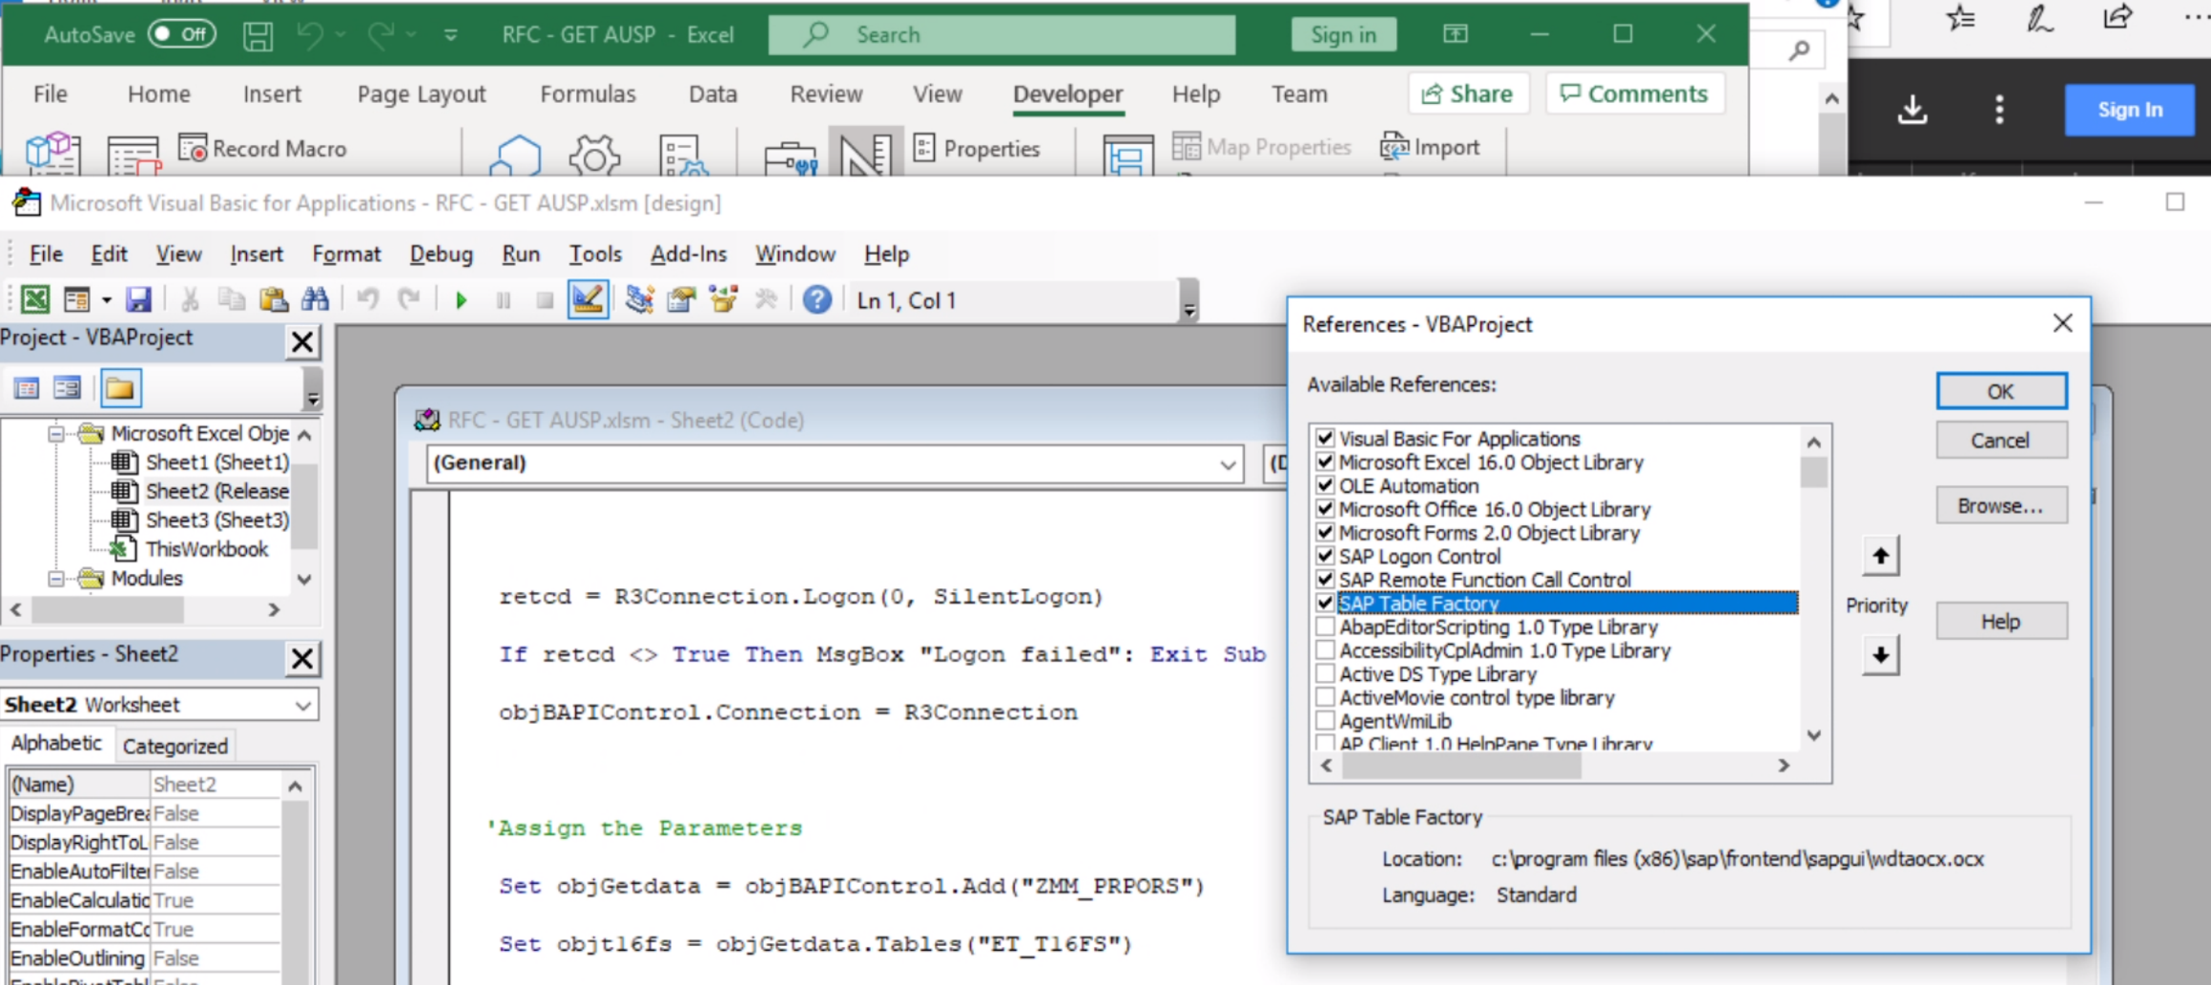
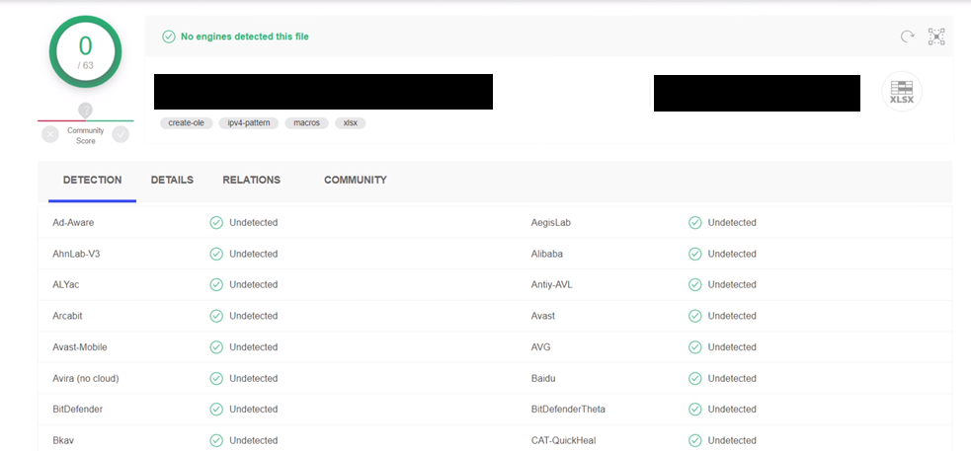
Phishing SAP users
Excel Macros
SAP Tables are accessible from Excel and VB via SAPGUI scripting. SSO will typically just sign you in and it will execute in the context of your user.
That’s great but we still need to know the hostname, client number, and maybe even domain.
ANTHOLOGY

Slide 11
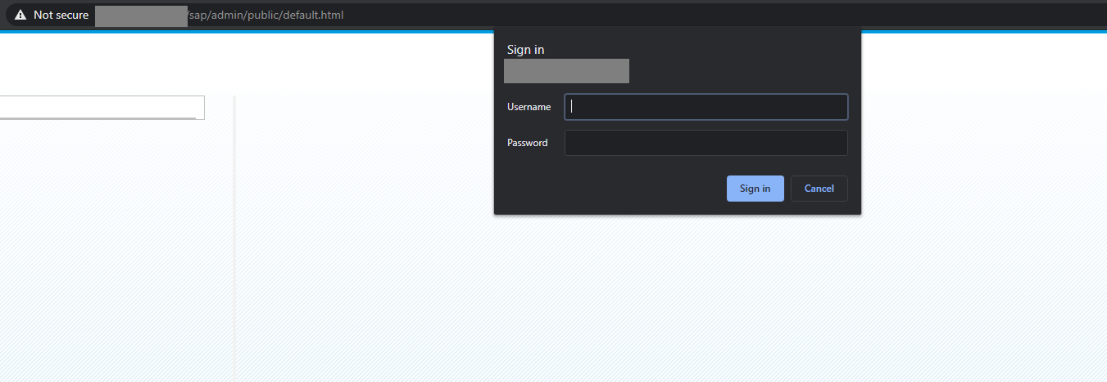
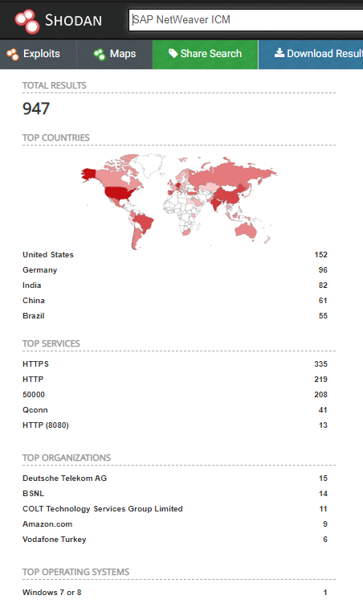
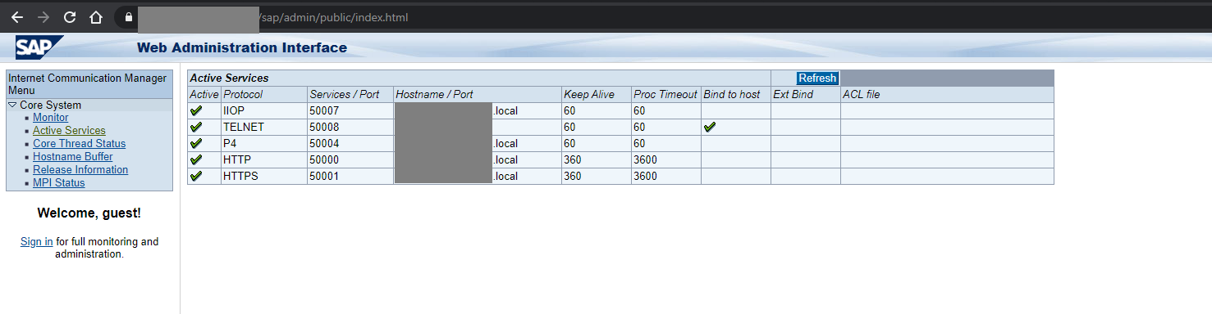
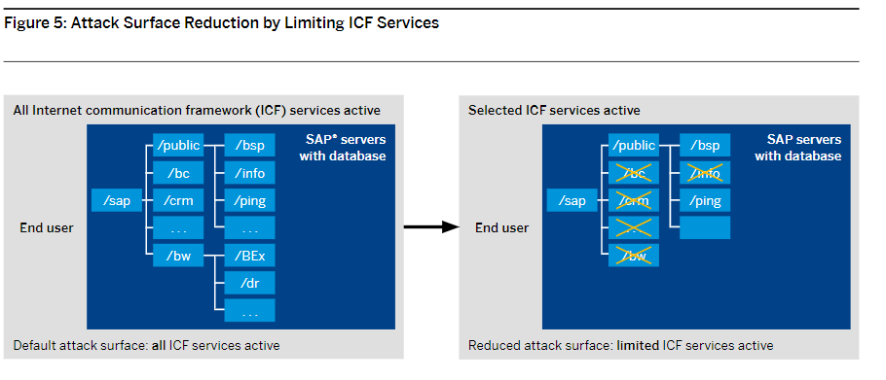
Hostnames Required?
Information Disclosure
Web Dispatcher
Discloses hostname, services, OS version, patches, etc..
Typically doesn’t require any auth
Auth bypass
Swap default.html for index.html
SAP Note 2258786 patch
/sap/public/info also worth a look
ANTHOLOGY

Slide 12

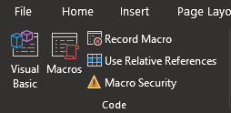
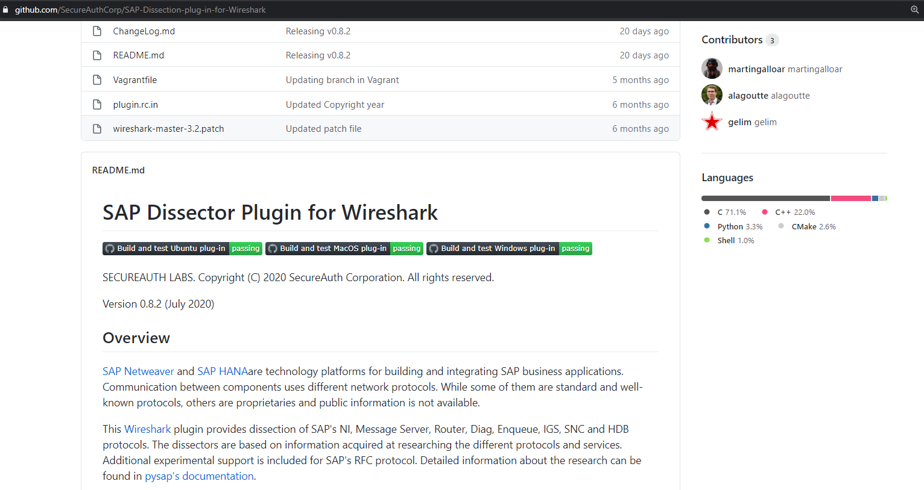
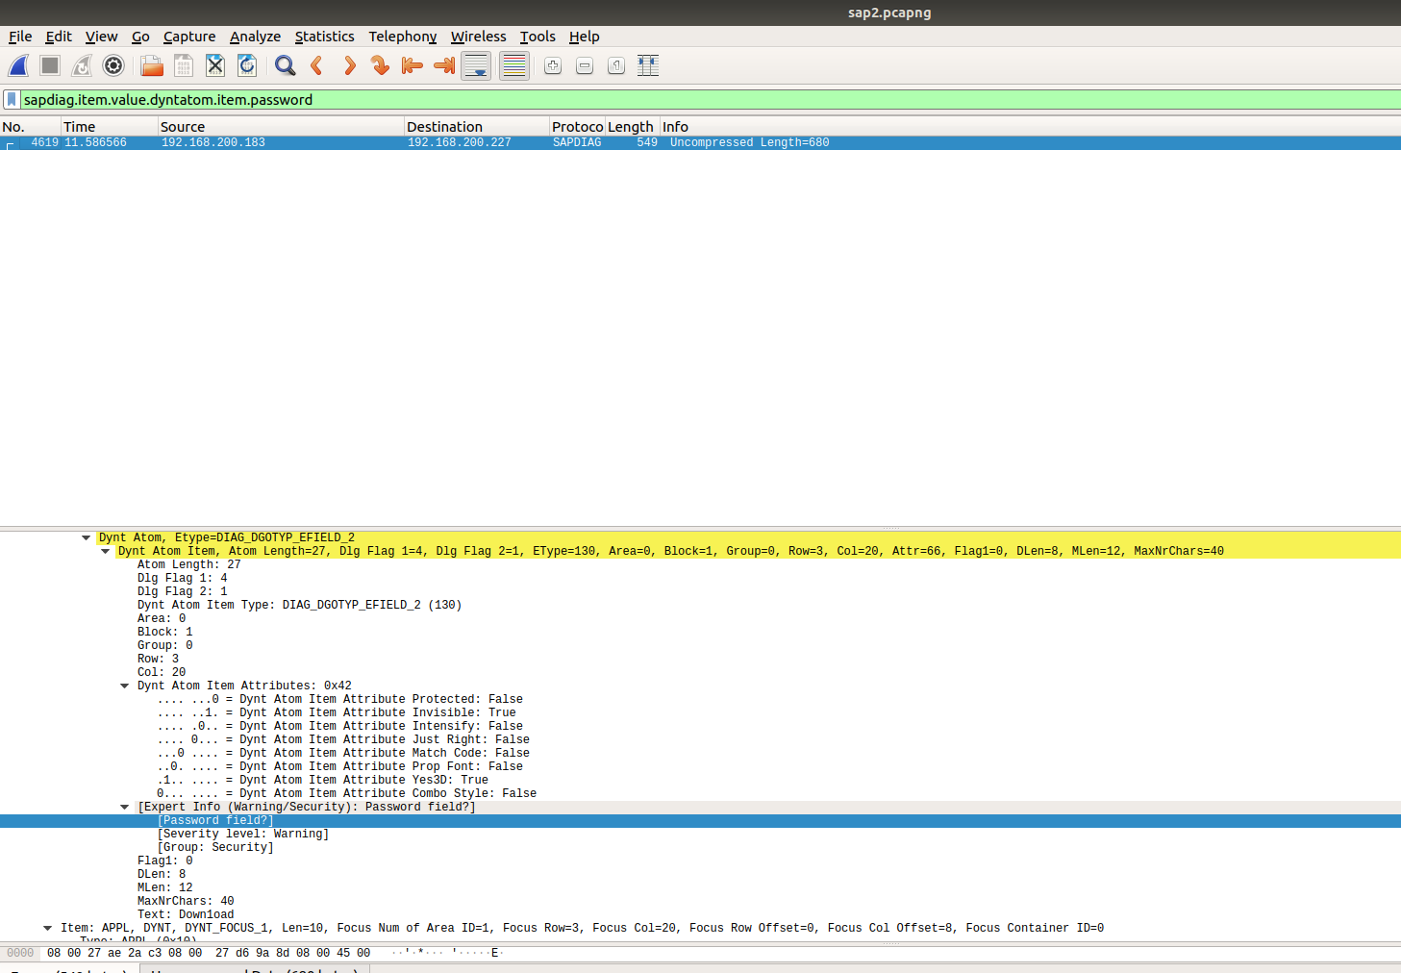

Grabbing Plaintext Creds
SAPGUI Macros
Regularly store hard-coded credentials as well, might also be some fun backdoor opportunities or persistence.
Sniffing Credentials
SAP Wireshark Dissector:
https://www.secureauth.com/labs/open-source-tools/sap-dissection-plug-wireshark
ANTHOLOGY

Slide 13
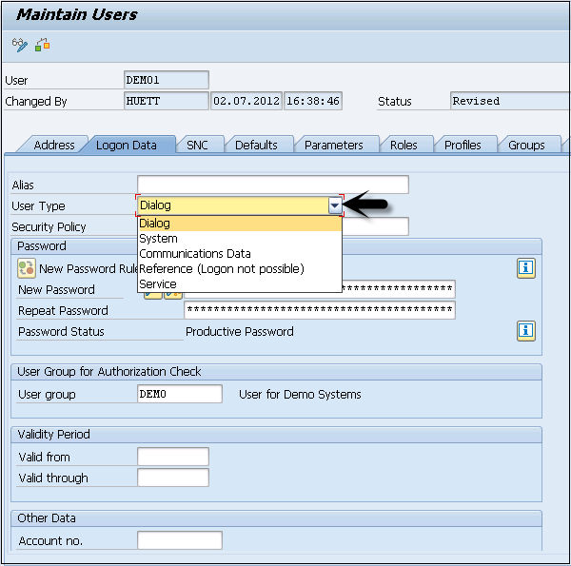
Dialog vs non-dialog users
User Types
Dialog user − This user is used for interactive system access from GUI.
System user − This user is used for background processing, communication within a system.
Communication user − This user is used for external RFC calls.
Service user − This user is created for a larger and anonymous group of users.
Reference user − It is not possible to log on to the system with this user type.
User accounts
Dialog users can simply login to the application. Non-dialog users might be able to make RFC calls to SAP. Many of these users have substantial rights.
ANTHOLOGY

Slide 14
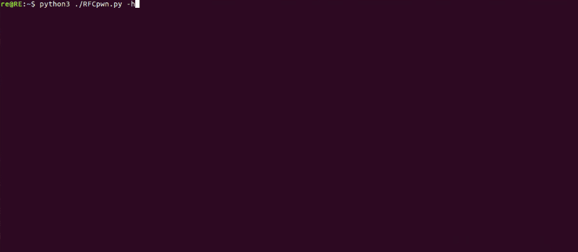
RFCPwn
Service -> Dialog
Github
https://github.com/icryo/RFCpwn
A toolkit for demonstrating the impact of compromised service accounts.
ANTHOLOGY

Slide 15
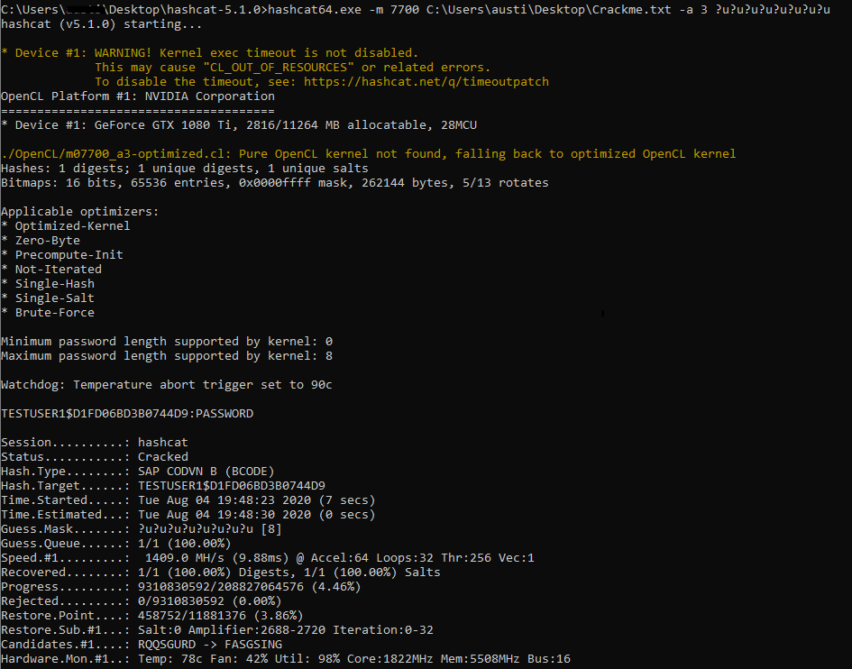
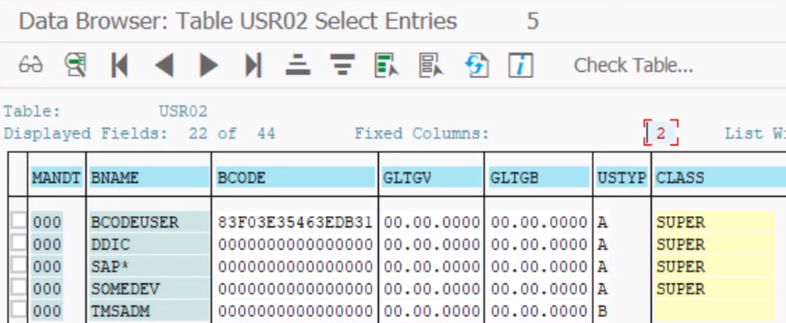
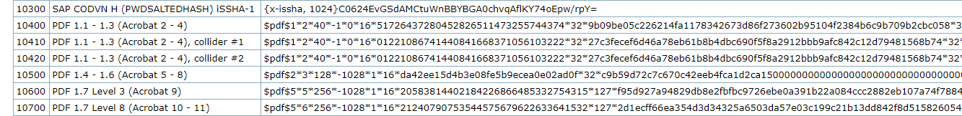
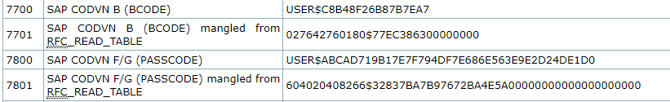
Cracking SAP hashes?
BCODE is best code
Three types of hashes
BCODE, passcode, & iSSHA-1
Quickest Cracks?
BCODE – Maximum password length is 8 characters and forced uppercase
Can be read from tables using RFC_TABLE_READ RFC_GET_TABLE_ENTRIES
or other table reading BAPIs
ANTHOLOGY

Slide 16
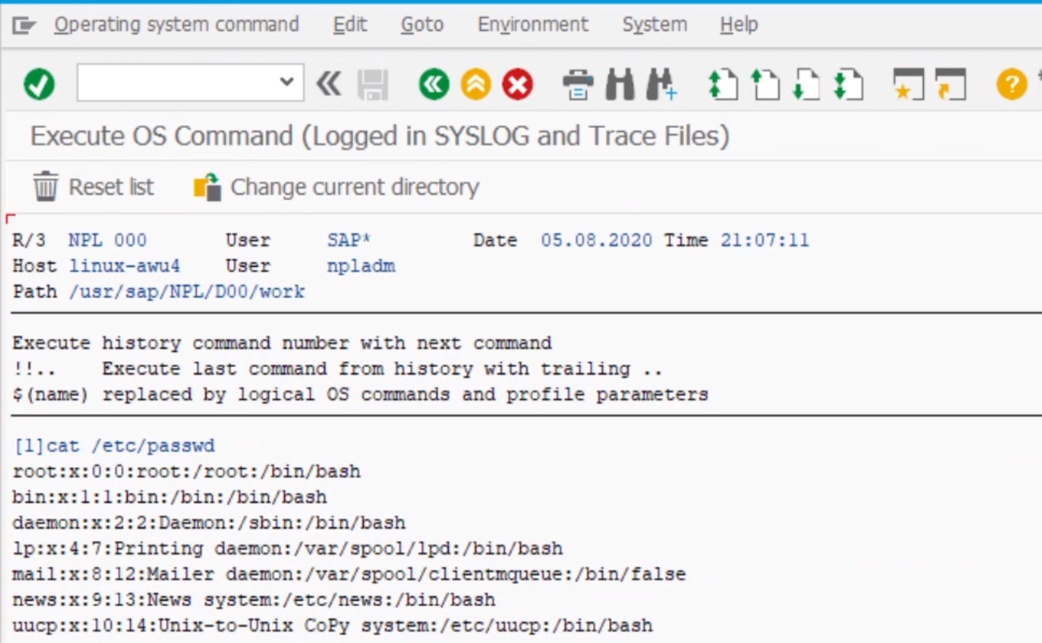
Code Execution
You can simply go to SE38 and execute the RSBDCOS0 report
If you’re new to SAP you’ll notice you can’t execute every command, but only commands that are defined within SAP.
ANTHOLOGY

Slide 17
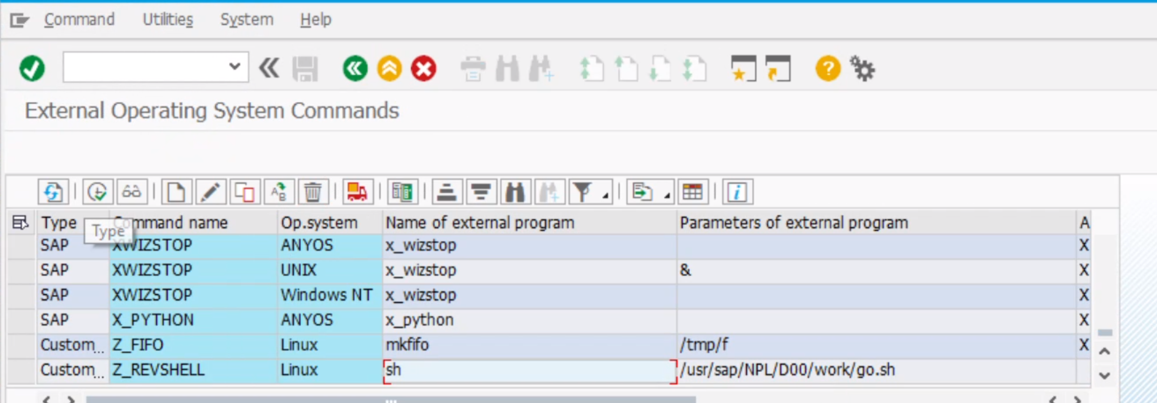
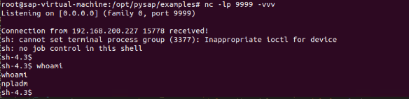
Code Execution
You can define new system commands in SM69 and even catch some reverse shells
Most instances have a non-standard version of netcat but the simple work around is to curl over a named pipe reverse shell
ANTHOLOGY

Slide 18
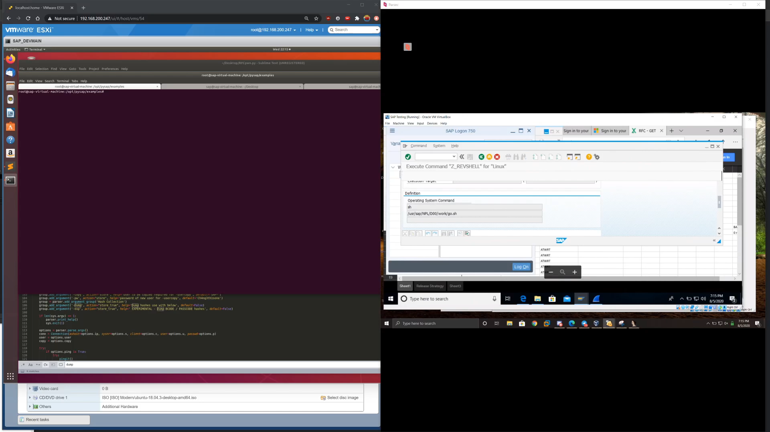
Quick Demo
ANTHOLOGY

Slide 19
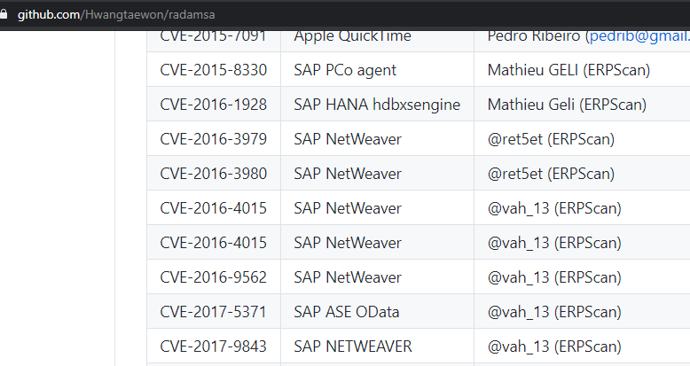
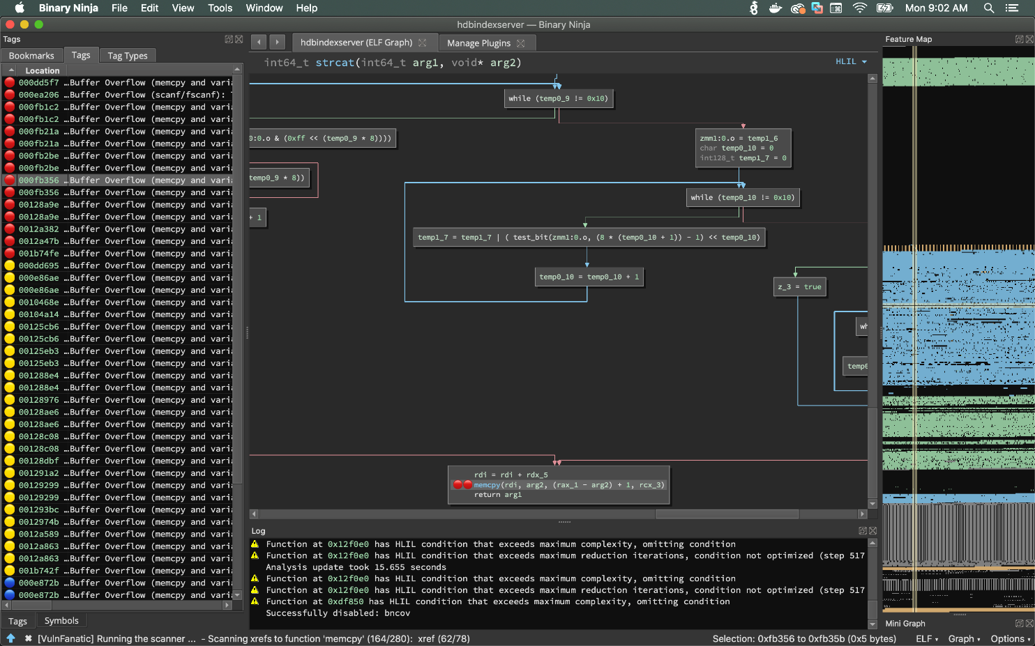
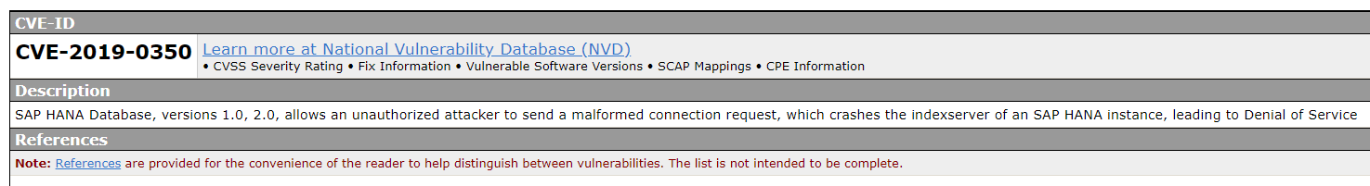
Fuzzing SAP
Radamsa
https://github.com/aoh/radamsa
Cisco Mutiny
https://github.com/Cisco-Talos/mutiny-fuzzer
VulnFanatic
https://github.com/Martyx00/VulnFanatic
Old PoC
https://github.com/icryo/CVE-2019-0350
ANTHOLOGY

Slide 20
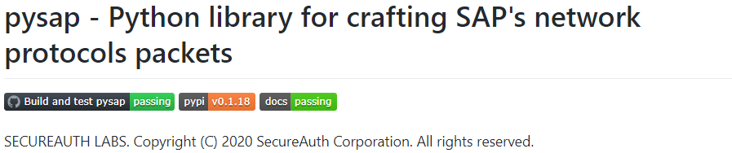
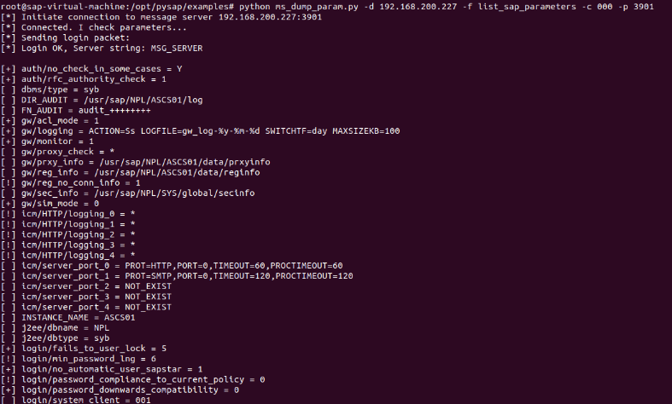
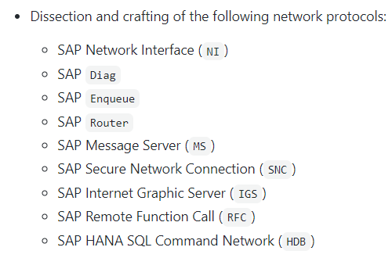
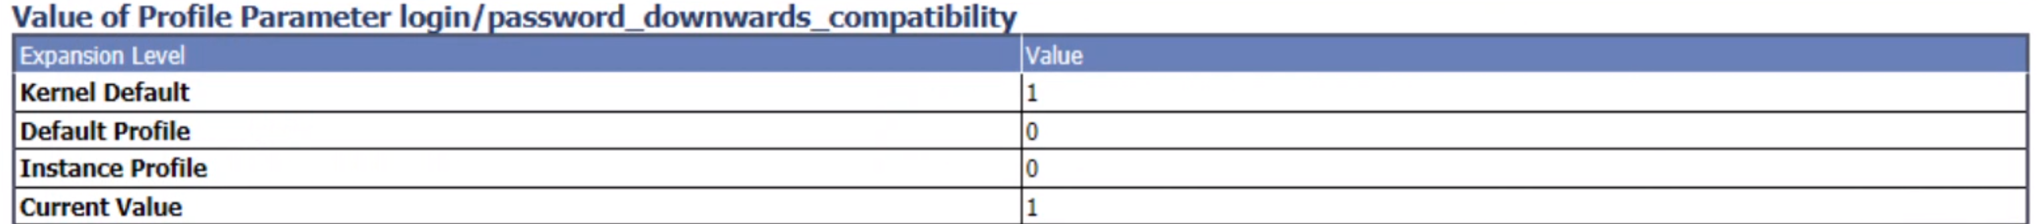
PYSAP
Impacket-ish SAP tools
SAP modules
Maintained by Martingalloar:
hdb_auth.py
router_scanner.py
Ms_dump_param.py – list_sap_parameters
diag_login_brute_force.py
Easily adapted to SAP fuzzers
ANTHOLOGY

Slide 21
What we covered
New fangled SAP vulns
Targeting SAP Users
Gathering Clear-text credentials
Code execution as non-dialog users
Fuzzing SAP as a target
PYSAP
ANTHOLOGY

Slide 22
Shout outs
Spencer Mcintyre @zeroSteiner
Martin Gallo @MartinGalloAr
Iggy @_1ggy
vah_13 @vah_13
Dmitry Chastuhin @_chipik
Jordan Santarcieri @jsantarsieri
@VicxerSecurity
@Onapsis
https://twitter.com/icryo
Discord: cryo #3148
ANTHOLOGY

Slide 23
QUESTION AND ANSWER
Q&A
ANTHOLOGY

Slide 24
THANK YOU FOR COMING

